Slide 1

Group 2 final project
By: Malik callaham
Joon jeong
Owen turnbull
Joshua woojin ko
INST 326-SECTION 102
5/5/21

Slide 2
Project Description & Goal
Using a dataset from Kaggle.com (Life Expectancy), our team will employ a variety of python techniques to identify various factors that influence the life expectancy rates in a country (or countries).
The goal of this project is to develop a way for users to find a correlation ( if any) of various factors that may have had an influence on lowering the value of life expectancy in selected countries from the years 2000 t0 2015.

Slide 3
Countries tested
The countries that are available for a user to test can be found both in the “NewLifeExpectancy.csv” file or “Final Project Countries” word document.
The available factors that will be presented in the output from the users’ country selection are as followed:
Life Expectancy (in age)
Year (ranges from 2000 to 2015 in most countries)
Polio (immunization amongst 1 year old's)
Total Expenditure (Government expenditure on health as a percentage)
Schooling (Number of years of schooling)
Income Composition of Resources (Human Development index in terms of income composition of resources. Index range of 0 to 1).
Alcohol (consumption)
Diphtheria (immunization amongst 1-year old's)
Adult Mortality (rates of both sexes between 15 and 60 years per 1000 population)
Population (population of the country)

Slide 4
What countries and factors were dropped?
Since there were some discrepancies amongst certain countries & factors within the original “Life Expectancy” CSV file used for the project, there was a need to drop unreliable and/or damaged data from the file, while the data that was reliable was written to a new CSV file called “NewLifeExpectancy”.
Additionally, here are the following factors that contained data discrepancies (missing data, unreliable data):
Infant deaths
Percentage expenditure
Hepatitis B
Measles
Under-five deaths
HIV/AIDS
GDP
Thinness 1-19 years
Thinness 5-9 years
BMI
Status

Slide 5
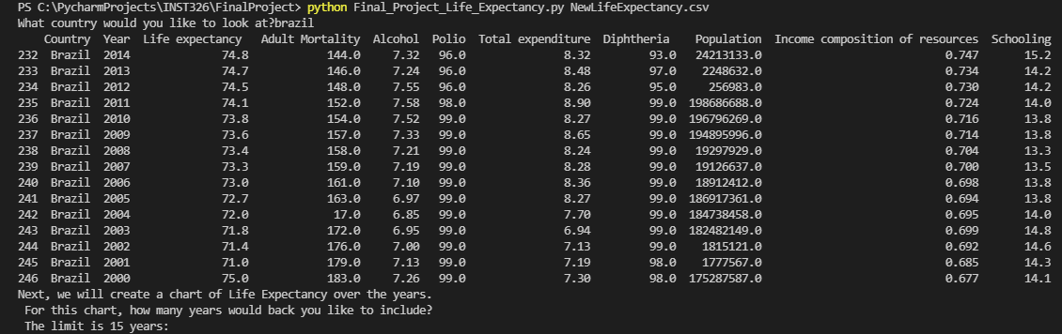
Example of user output (what a user should see) Pt.1

Slide 6
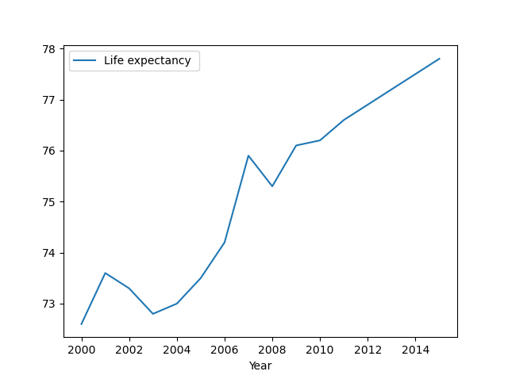
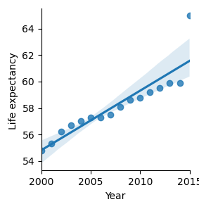
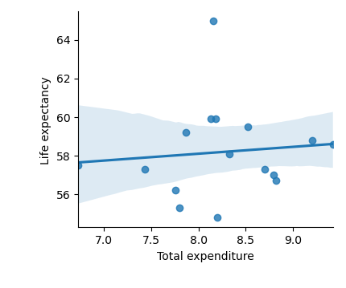
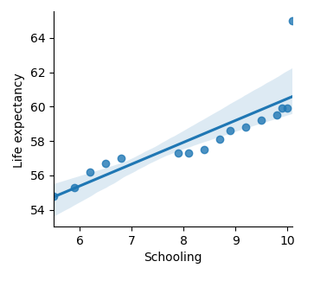
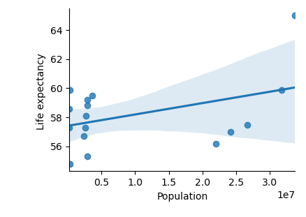
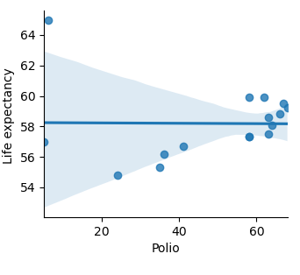
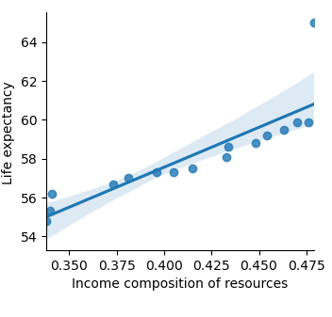
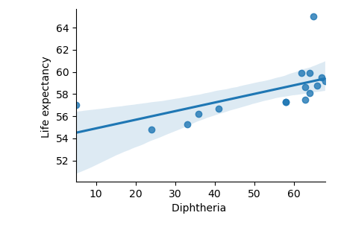
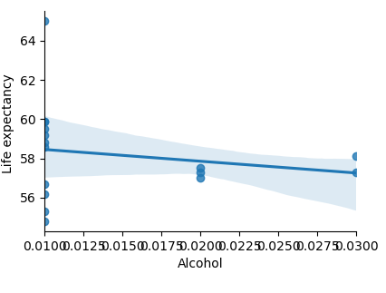
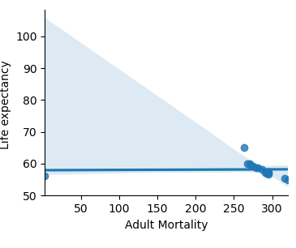
Example of user output pt. iI

Slide 7
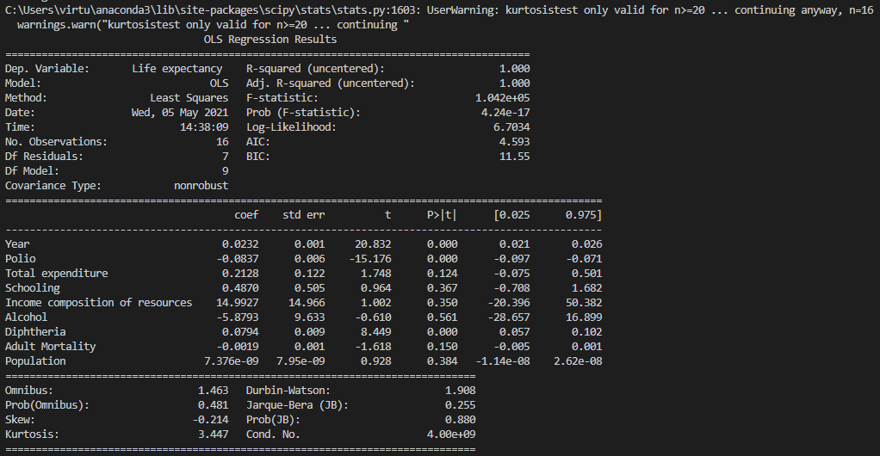
Example user output pt. iii (Linear regression model)

Slide 8

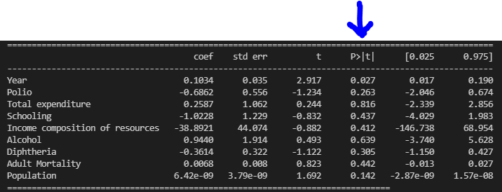
explanation
When the user executes the Final_Project_Life_Expectancy.py file, they are asked what country they would like to look at. Once the user inputs a country name, they are then asked to input the number of years of life expectancy they are interested in seeing from the specified country. This results in a separate line graph showcasing the relationship between life expectancy & years.
The second thing that the user will be presented are the graphs for each factor tested (there are 9 in total). In each graph, a country’s “Life Expectancy” is the y-axis, and each corresponding factor of influence is on the x-axis.
The last thing the file will generate is a linear regression model detailing the coefficient, t & p-values of each factor. By using the statsmodels.api library, a user can see the significance of each factor by specifically the looking at the P > | t | p-value in the regression model. A p-value that is less than 0.05 is statistically significant.

Slide 9
Conclusion/additional thoughts
While there was dropped data from the “NewLifeExpectancy.csv” file, our team still found it interesting enough to conduct a project around the various factors that may have had an influence on the life expectancy rates in various countries. We hope that users who test our code find the data just as interesting as well.
One thing that would have probably been a great help is if the Life Expectancy data on Kaggle.com was updated to at least 2020 or 2021 as this could have possibly updated old data to current data.

